Slide 1

Base64
CEO/Lead Instructor: Brandon Dennis, OSCP

Slide 2
What is Base64
This encoding scheme is used for the HTTP protocol
Inside of HTTP it is used to transfer data safely
It was invented as part of the MIME content transfer encoding

Slide 3
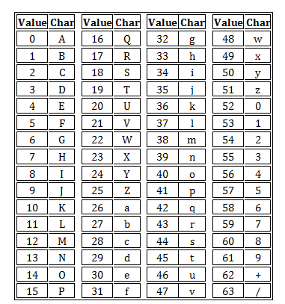
How it works
Base64 will divide the bytes of the entire set of data into groups of 6 bits
Every 6 bits or group will be provided a specific character based on the following table:

Slide 4
How it works cont
Because this is represented in 6 bit intervals the base64 encoded data will be about 33% larger than the original data
Example:
We have a string ‘Ow!’
We will convert each of these characters to hex (0x4F, 0x77, 0x21)
Now we will convert these 3 bytes into 24 bits (010001111 01110111 00100001)
With these 24 bits we will group them in sets of 6 (010011, 110111, 011100, 1000001)
Now we convert each of these 6 bits into a digit (will be within 0 and 63)
Finally we have our output text: ‘T3ch’

Slide 5
How it works cont
It is important to understand that these must be in 6 bit groups
If it is not it will pad the end of the bits with 0
This is why you are commonly seeing and ‘=‘ at the end of a base64 string

